Slide 1

Intruction Of Project
Team name: Just do
Group toplic：Student System Management
Member:ZengYujin,
WangMing,
WangZhiwei,
LeiYu

Slide 2
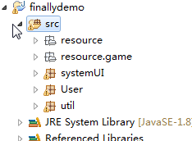
The project structure

Slide 3
Util package
1.BGM -- release BGM.java
2.JDBC -- DBcls.java
3.LanguagueChange -- Language.java
4.Skin -- MyLookAndFeel.java
5.Background Picture -- UiUtil.java

Slide 4
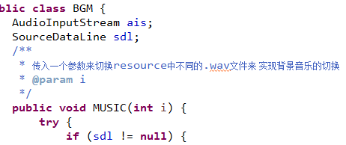
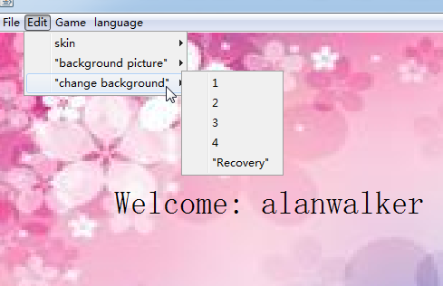
BGM.java

Slide 5
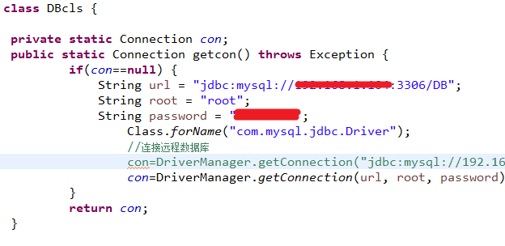
DBcls.java

Slide 6
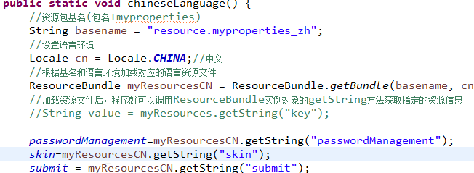
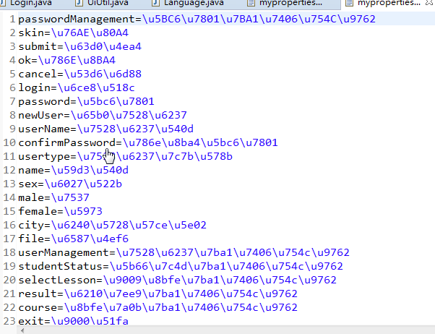

Language.java

Slide 7
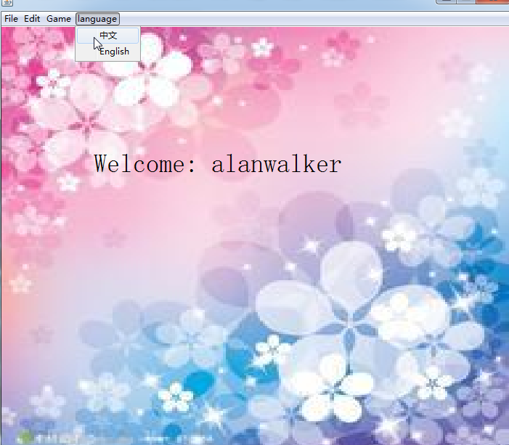
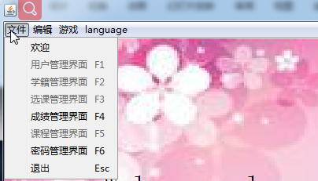
Language.java

Slide 8
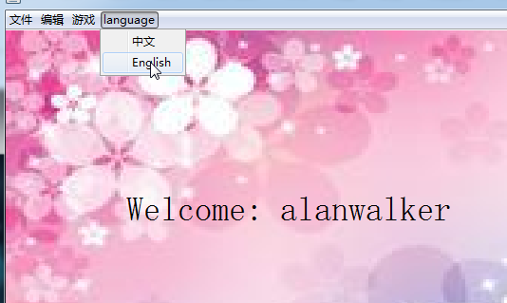
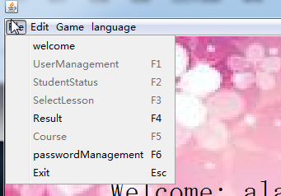
Language.java

Slide 9
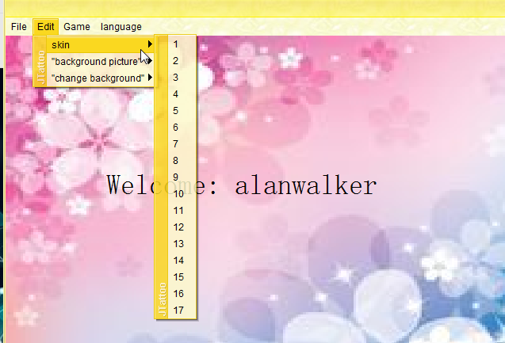
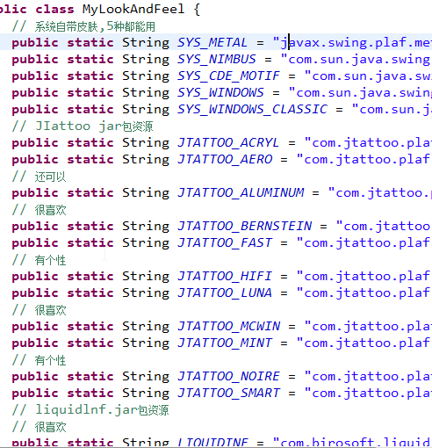
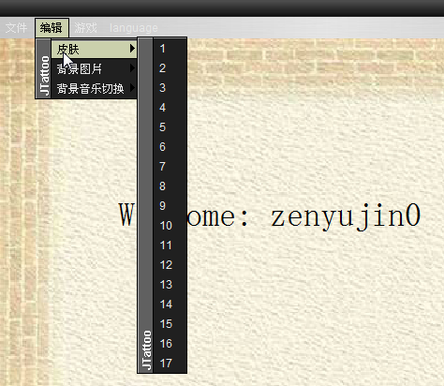
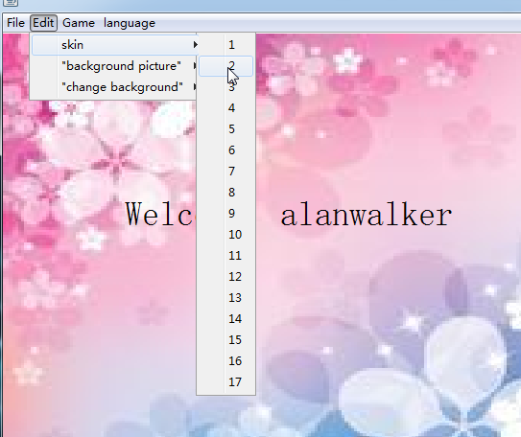
MyLookAndFeel.java

Slide 10
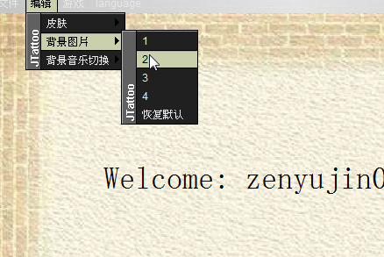
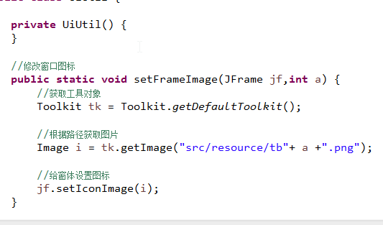
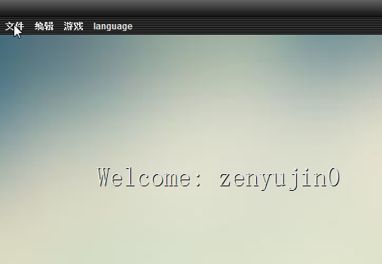
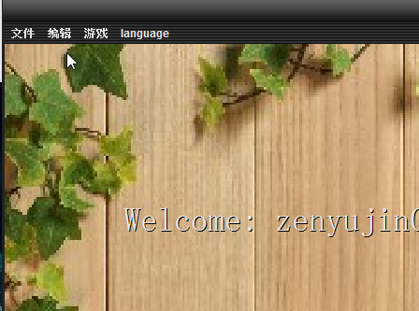
UiUtil.java

Slide 11
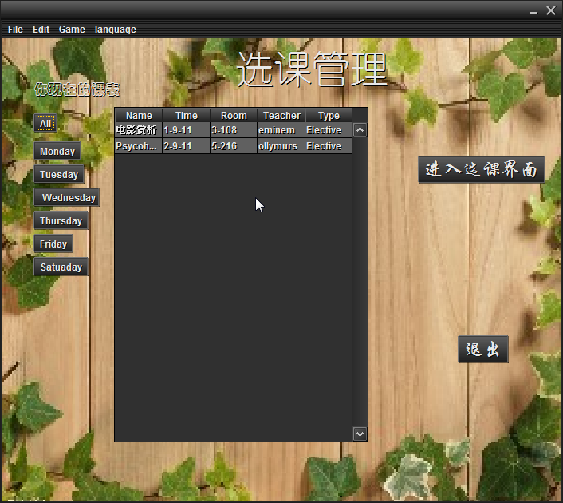
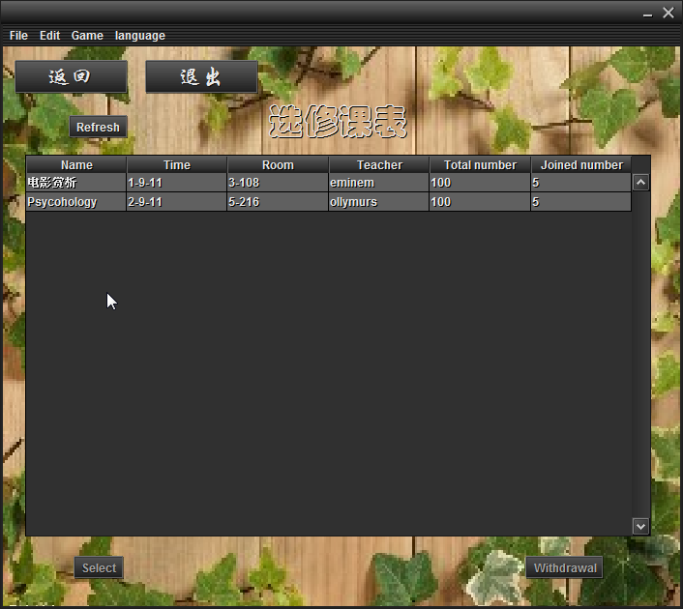
course selection management
The Student can select what they want in this Interface.

Slide 12
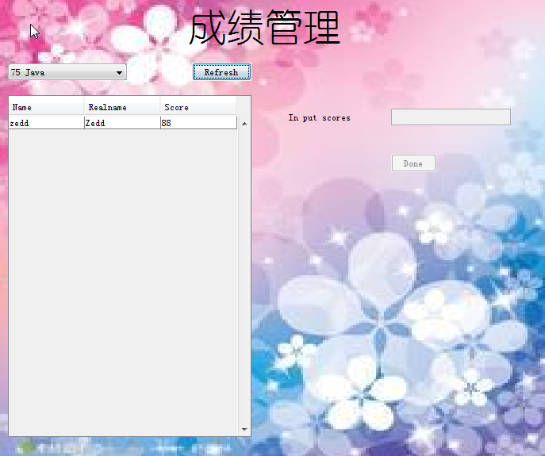
grade management
The teacher can Change the Marks of Students.

Slide 13
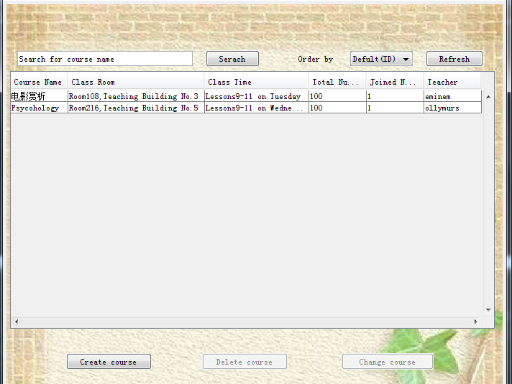
Course manage system
Change and Delete operation can be performed when the course is selected.Search and order by button can simplify retrieval.

Slide 14
Course manage system
Change and Delete operation can be performed when the course is selected.Search and order by button can simplify retrieval.

Slide 15
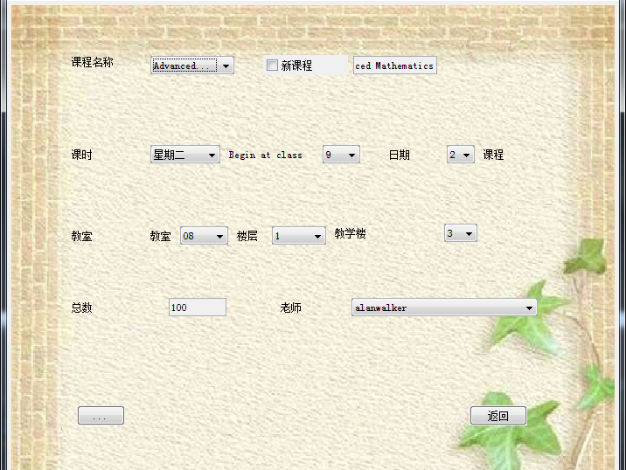
Create a Course
Many parameters of the course can be modified in this page.

Slide 16
Change Course Parameters
Same function as Create page,and in this page,course ID will be indicated.

Slide 17
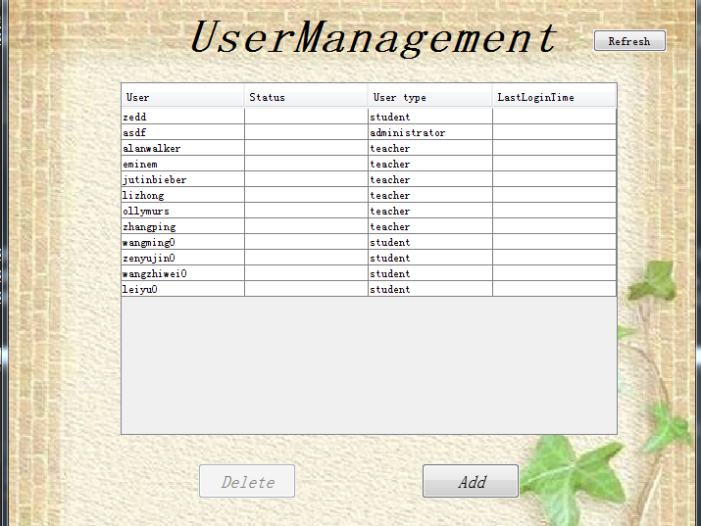
User management
Administrator can delete users or create a new user in this interface.

Slide 18
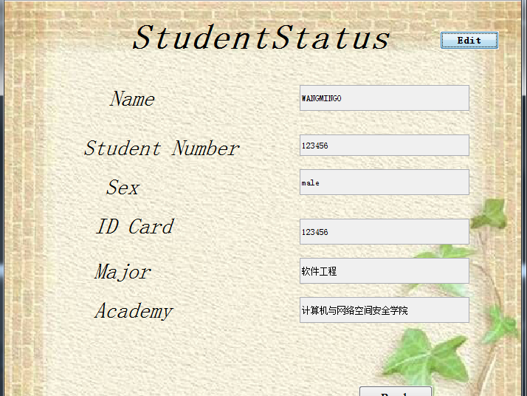
This interface shows the detailed information of students and we can modify it.

Slide 19
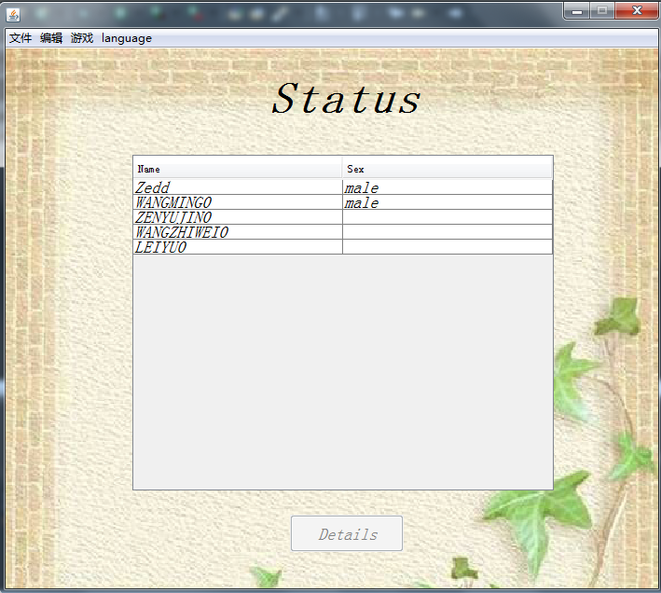
Student status management
This is the interface for querying student registration information.

Slide 20
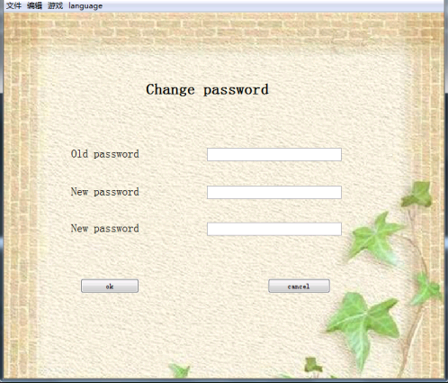
Change the password
password can be judged,if the password is not compose
of numbers and letters,it will report an error.

